Slide 1
Pin and Password Security
Michael Amista’ - Gabriel Rovesti
Advanced Topics in Computer Network and Security
2023-2024

Slide 2
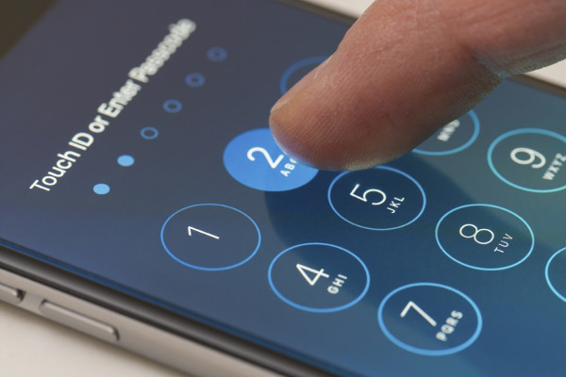
PIN sounds good… but is it?
Easy Simple But secure?

Slide 3
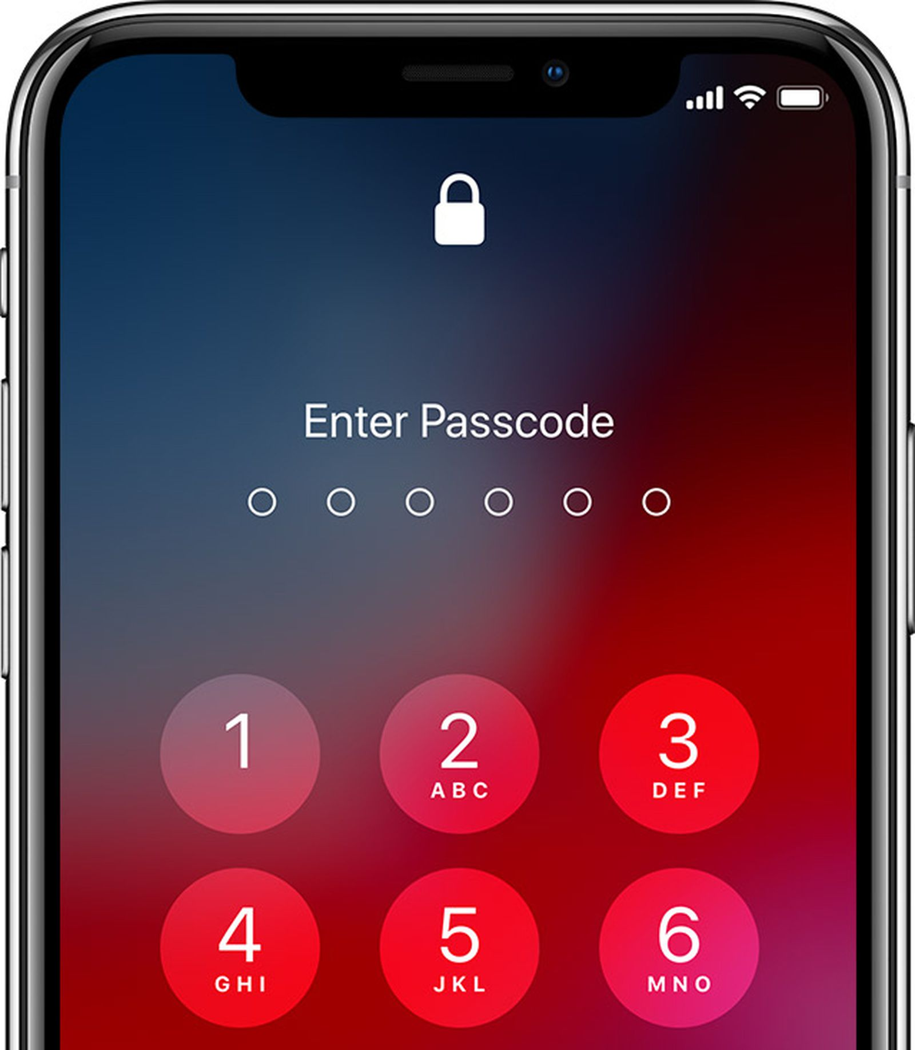
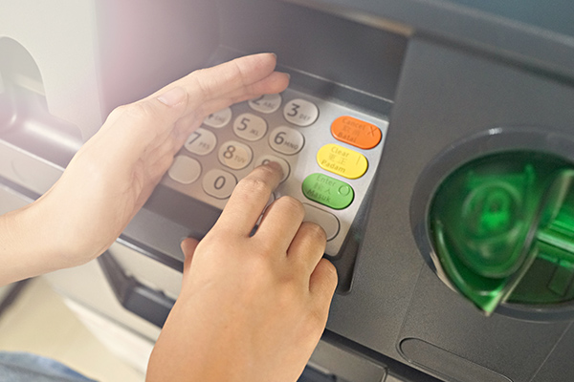
Where are PINs used?
Classical
Modern

Slide 4
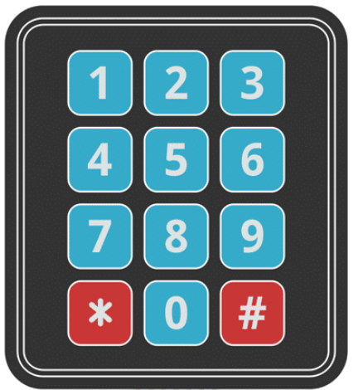

How are ATM PINs exploited?
Acoustic
Non-acoustic

Slide 5
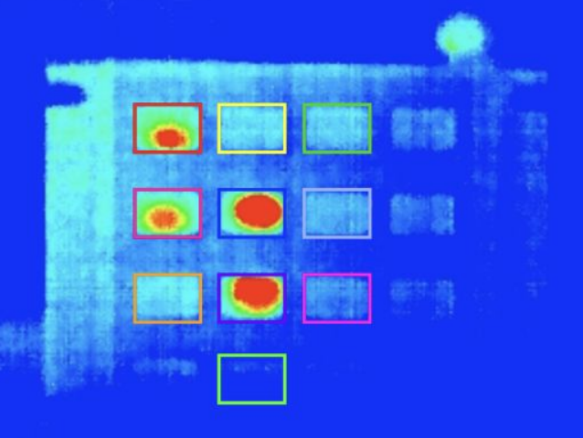
How to track and study PINs?

Slide 6
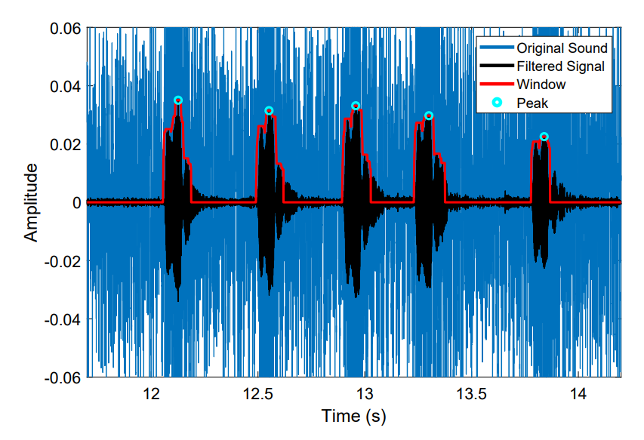
How to track and study PINs?

Slide 7

Happy ending

